Slide 1


Predictive Student Analysis

Slide 2
Outline
The Problem
Solution Proposal
Flow Analysis
Data Collection
Data Preprocessing
Model evaluation
Next Steps

Slide 3
The Problem

Slide 4
Problem statement
Retaining students is becoming more crucial to the university bottom line. Thus, institutions are interested in analyzing demographic and performance data to predict whether a student will stay on track in her courses, or require support so that she does not fall behind.
A recent study showed that more than two-thirds of teachers do not feel that the data and the tools they rely on are effective for guiding instruction and helping students. And with student-to-teacher ratios growing and performance expectations increasing, pressure is mounting to do more with the information available, more quickly, to impact more students.

Slide 5
Solution Proposal

Slide 6
Solution description
Predictive data analysis provides a snapshot of what students know, what they should know, and what can be done to meet their academic needs. With appropriate analysis and interpretation of data, educators can make informed decisions that positively affect student outcomes.
Provide a 360-degree view of a student, offering custom data displays to help teachers and students identify and resolve learning gaps faster attempting to study student disengagement at it’ s root level.
Build early alert system to alert faculty so they can intervene, before learning gaps become classroom performance issues

Slide 7
Technology Stack

Slide 8
Python
Data manipulation and analysis tool
Pandas
Machine Learning library
Scikit Learn
For data storage
Excel
Interactive dashboard using Dash framework Python
Web app

Slide 9
Assumptions
State your assumptions or any unknowns here.

Slide 10
Flow analysis

Slide 11
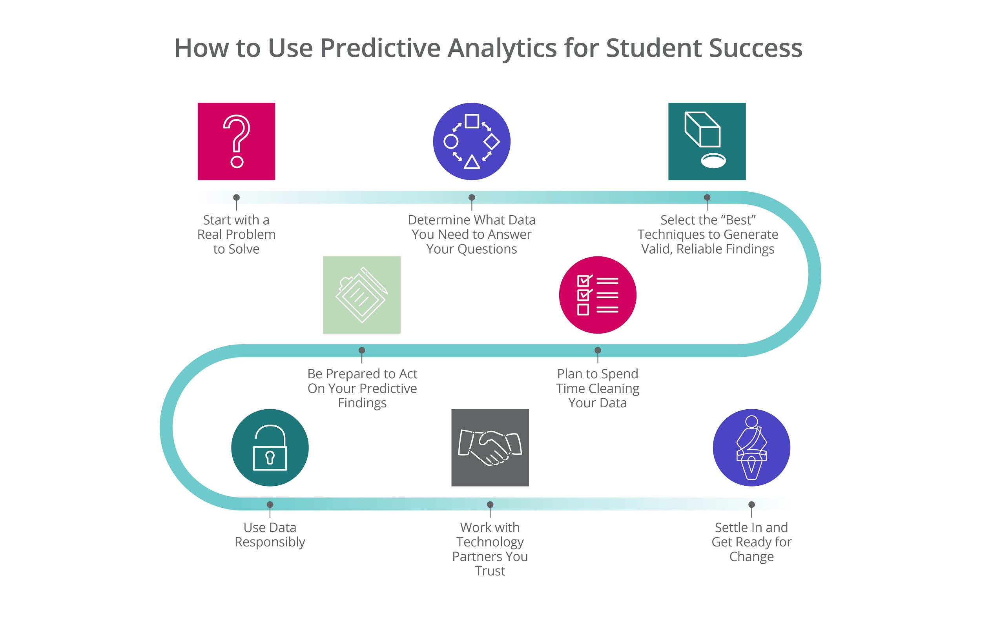

Slide 12
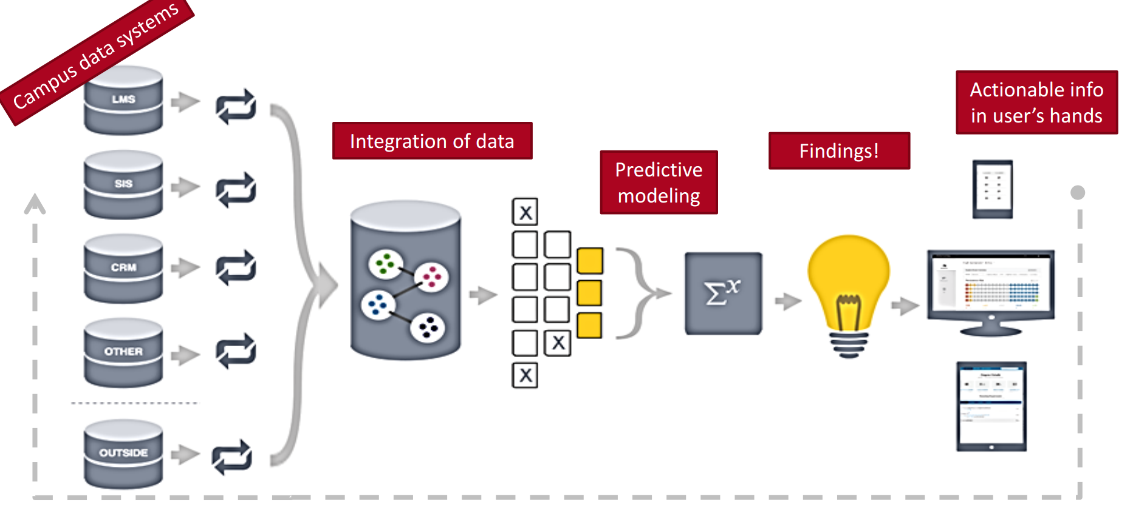

Slide 13
Data Collection
Data Preprocessing
Model selection and evaluation
Display results in interactive dashboard

Slide 14
Data Collection

Slide 15
Steps for data collection
Identify what features affect student disengagement the most
Based on research papers and brainstorming discussion with peers.
Collect other general details of students
Common attributes for identification and contact
Populate selected attributes with appropriate values

Slide 16
Attributes
Roll no Study_hrs Health
Tuition Source_fees Drop_year
Campus_feedback Travel_time Family_type
Annual_income Father_edu Father_occupation
Mother_education Mother_occupation Mother tongue
Challenges_family Caste Backlogs
Ssc Hsc Medium
Gender Course_id Backlog
Attendance Test
Notes:
26 * 1476

Slide 17
Data Preprocessing

Slide 18
Encoding Features
Encoding Labels
When converting a nominal attribute to numeric, one numeric attribute per nominal label is created. Each attribute is set to one if the corresponding nominal label is set, and zero otherwise.
LabelEncoder Encode labels with value between 0 and n_classes-1.

Slide 19
Feature Selection
When converting a nominal attribute to numeric, one numeric attribute per nominal label is created. Each attribute is set to one if the corresponding nominal label is set, and zero otherwise.
· Reduces Overfitting: Less redundant data means less opportunity to make decisions based on noise.
· Improves Accuracy: Less misleading data means modelling accuracy improves.
· Reduces Training Time: Less data means that algorithms train faster.

Slide 20
Classifier Selection

Slide 21
K-Folds Cross Validation Iterator
cross_val_score
Provides train/test indices to split data in train test sets. Split dataset into k consecutive folds (without shuffling by default).
Each fold is then used a validation set once while the k - 1 remaining fold form the training set.
By default cross_val_score uses the scoring provided in the given estimator, which is usually the simplest appropriate scoring method. E.g. for most classifiers this is accuracy score and for regressors this is r2 score.

Slide 22
Linear Regression
Decision Tree
Best fit dependant and independant

Slide 23
SVM(support vector machine)
Naive Bayes
Best fit dependant and independant

Slide 24
Random Forest
Naive Bayes
Best fit dependant and independant

Slide 25
Next Steps

Slide 26
Timeline
JAN
FEB
MARCH
TODAY
APRIL
MAY
Requirements gathering and research
Data collection and preparation
Model evaluation
Backlog prediction
SPI Prediction and Dashboard creation
Testing and User satisfaction
Maintenance

Slide 27
Questions?

